Slide 1
ANTS Profiler
Day 5 - Chapter 2

Slide 2
ANTS Profiler
Trial version of ANTS profiler available for 14 days
http://www.red-gate.com/dynamic/products/dotnet-development/ants-performance-profiler/download
It can be used for code, SQL, IO profiling
Profiling examples
http://www.red-gate.com/products/dotnet-development/ants-memory-profiler/walkthrough
https://documentation.red-gate.com/display/APP8/Worked+example+-+Profiling+an+ASP.NET+application
E:\VSTS Training\eurofins\Excercise
Attach two databases in SQL administrator located at ..\NerdDinner_2.0\NerdDinner\App_Data
Update file with server name: ConnectionStrings.config
In case sample apple doesn’t work use other app
E:\VSTS Training\SampleApp_Suj

Slide 3
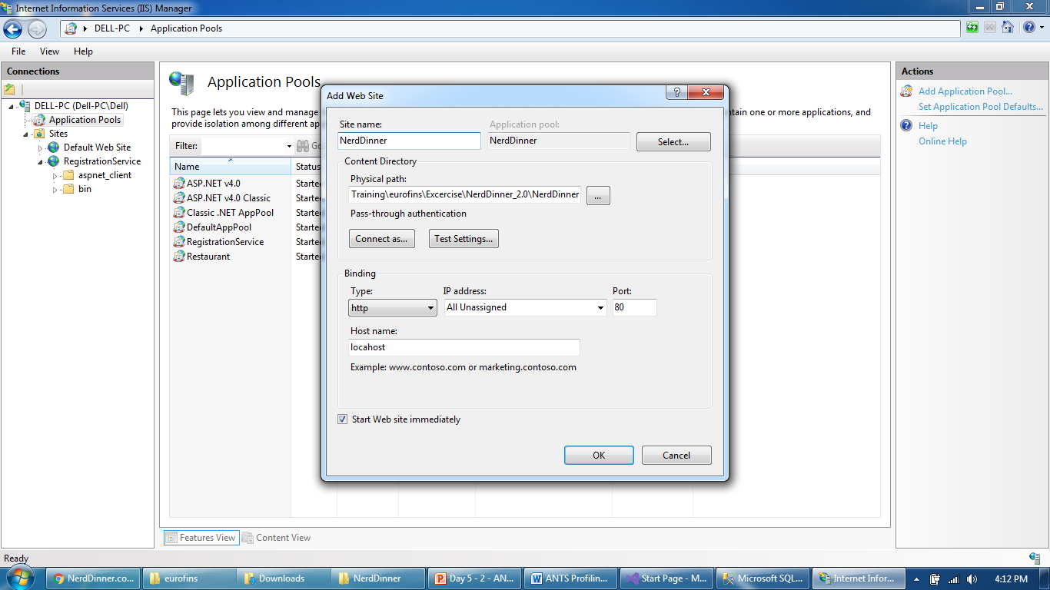
ANTS Profiler
Publish a solution by opening it in visual studio and provide it’s physical path while adding to a web site

Slide 4
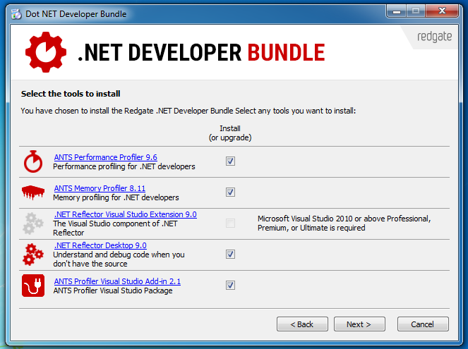
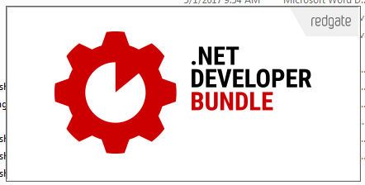
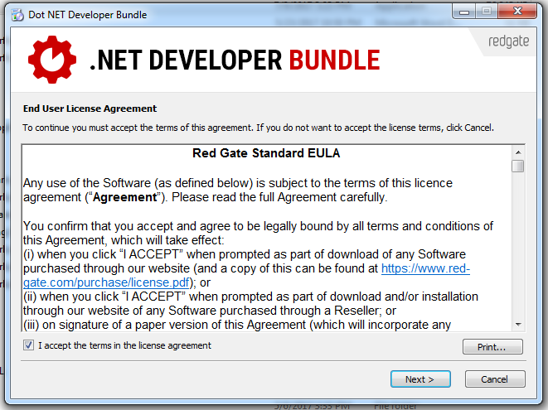
ANTS Profiler
Install ANTS profiler (redgate product)

Slide 5
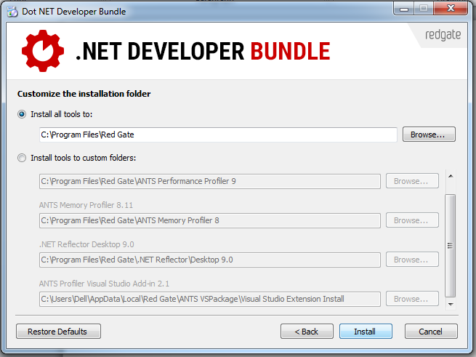
ANTS Profiler
Install ANTS profiler (redgate product)

Slide 6
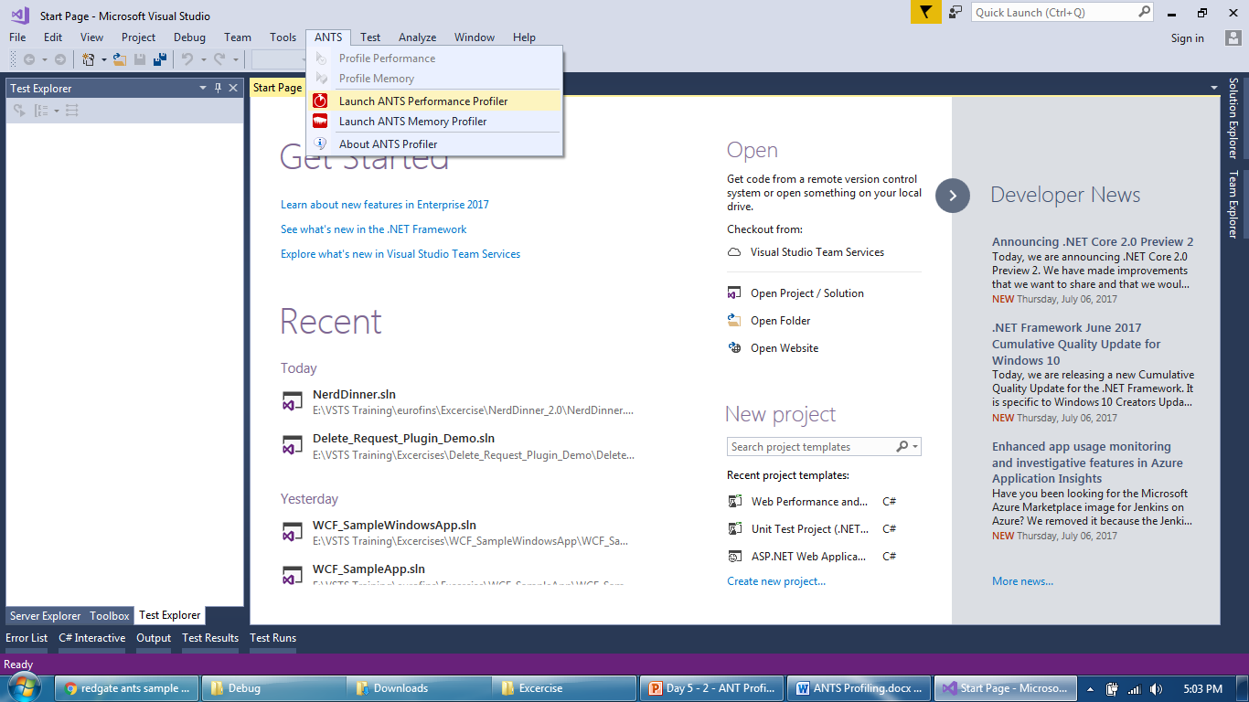
ANTS Profiler
Open ANTS performance profiler

Slide 7
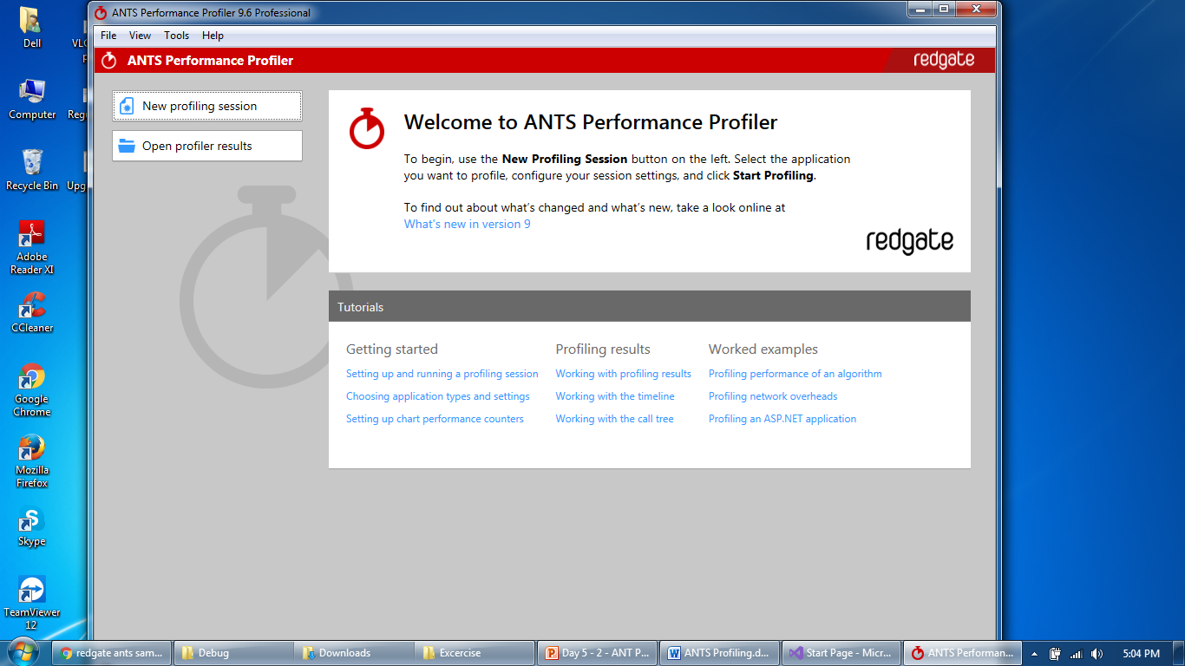
ANTS Profiler
Continue with trial version and click “New Performance Profiler”

Slide 8
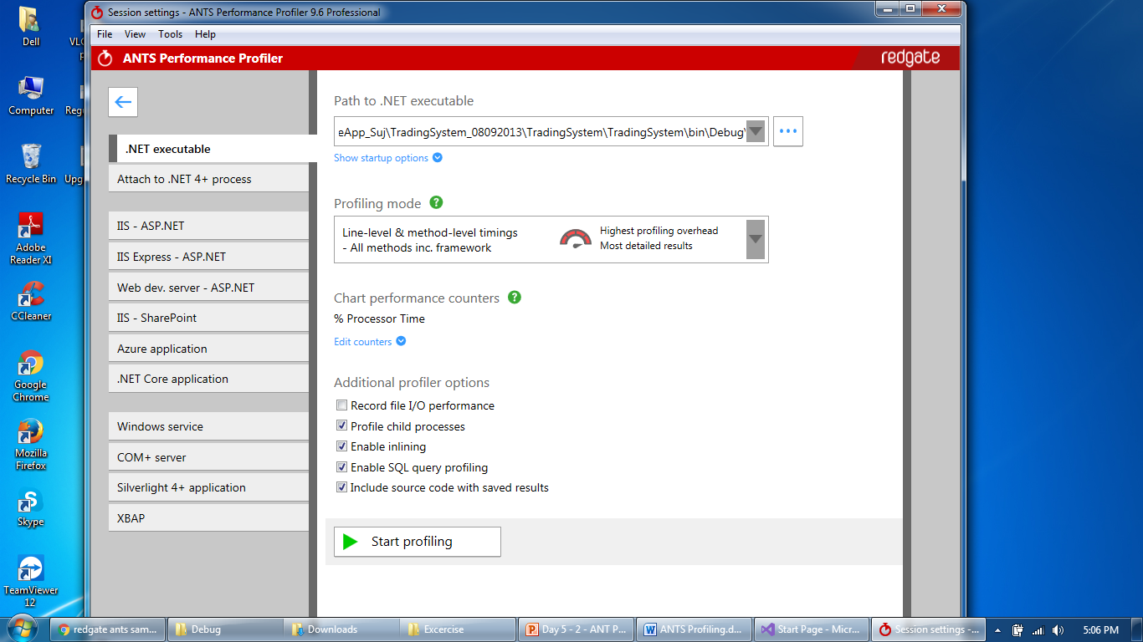
ANTS Profiler
Click on Start Profiling

Slide 9
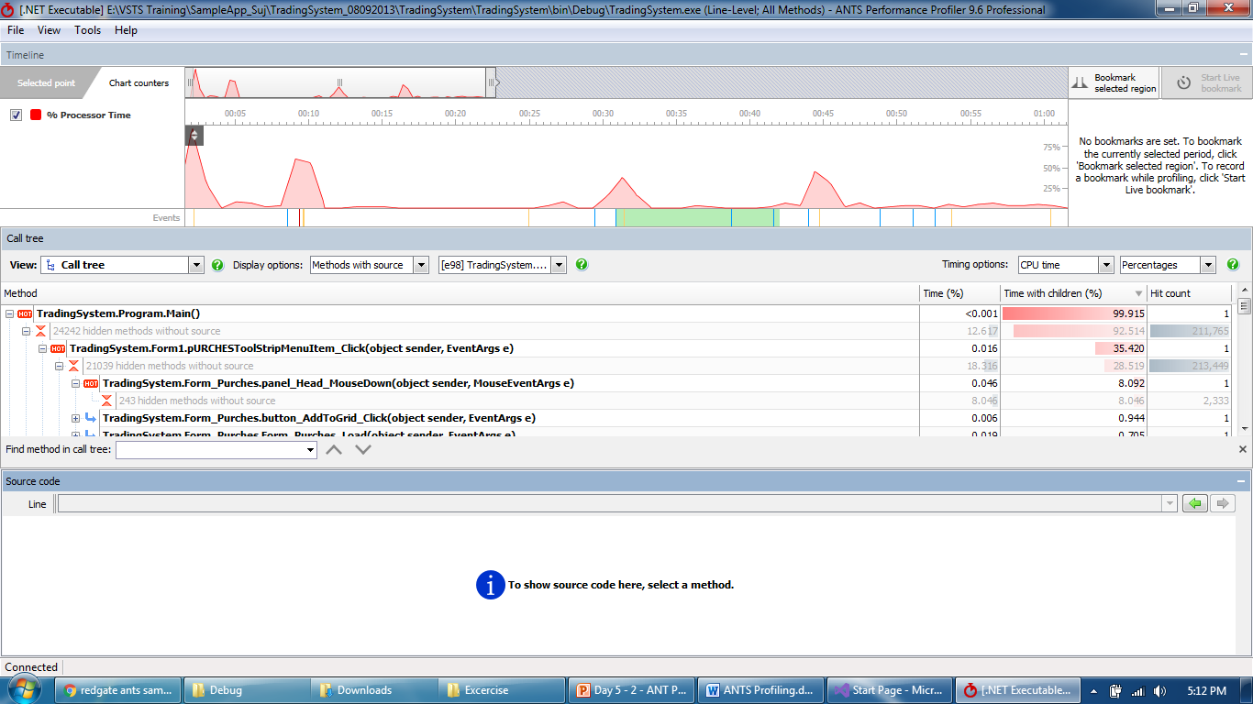
ANTS Profiler
As soon as you start profiling, there will be activity in the session

Slide 10
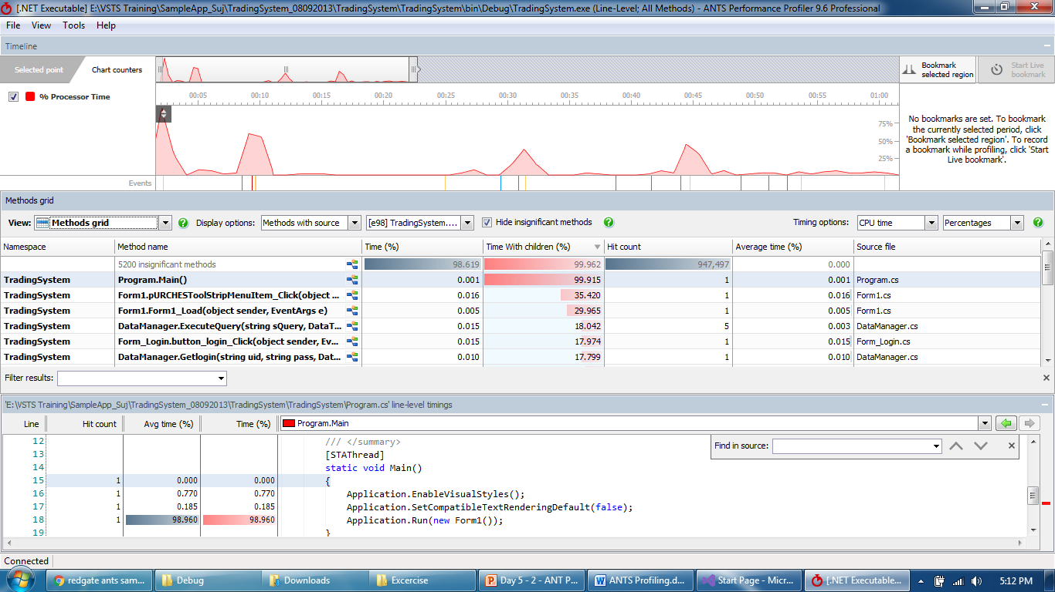
ANTS Profiler
Different view will help to drill down to root cause like Methods grid, Call tree, database calls

Slide 11
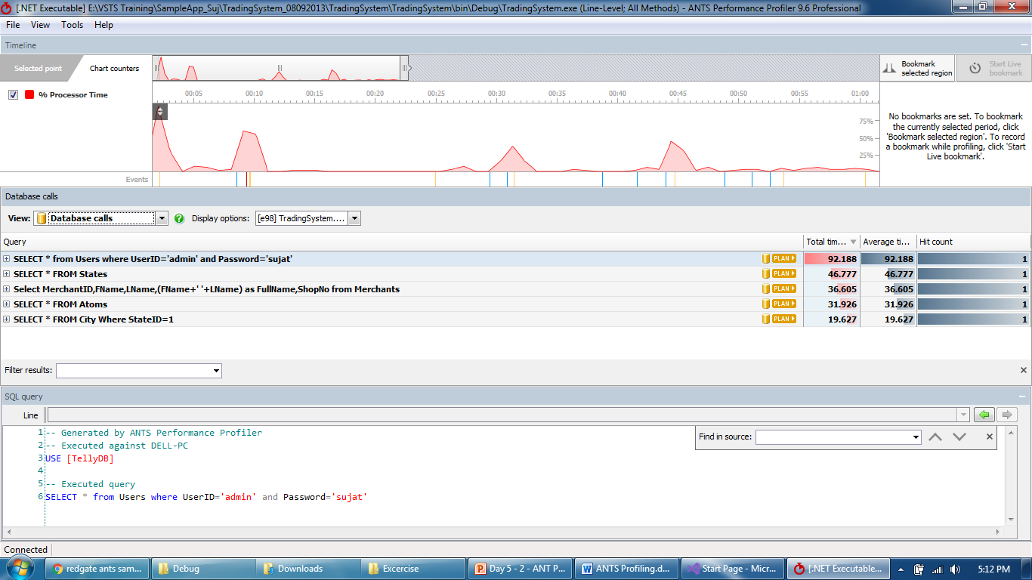
ANTS Profiler
It will show even SQL query or source code related to selected object

Slide 12
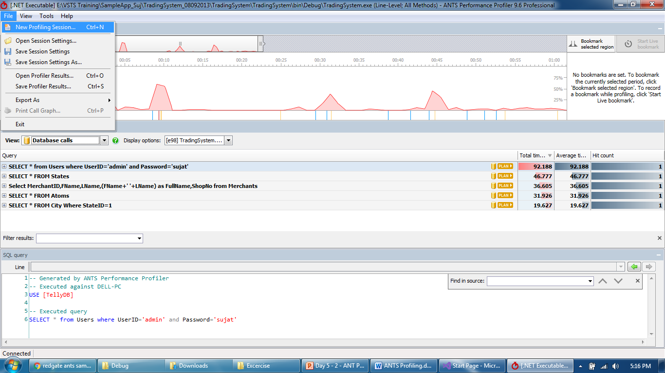
ANTS Profiler
Session can be saved and analyzed later by opening it again

Slide 13
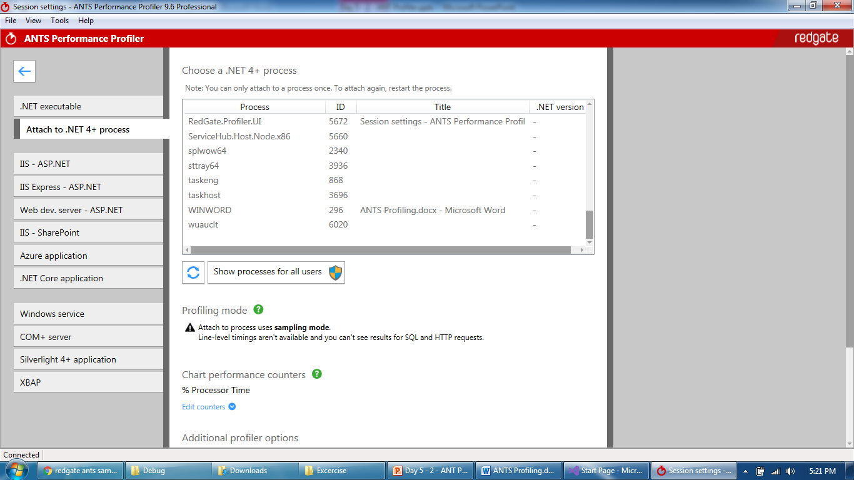
ANTS Profiler
ANTS profiler can also be attached to existing process

Slide 14
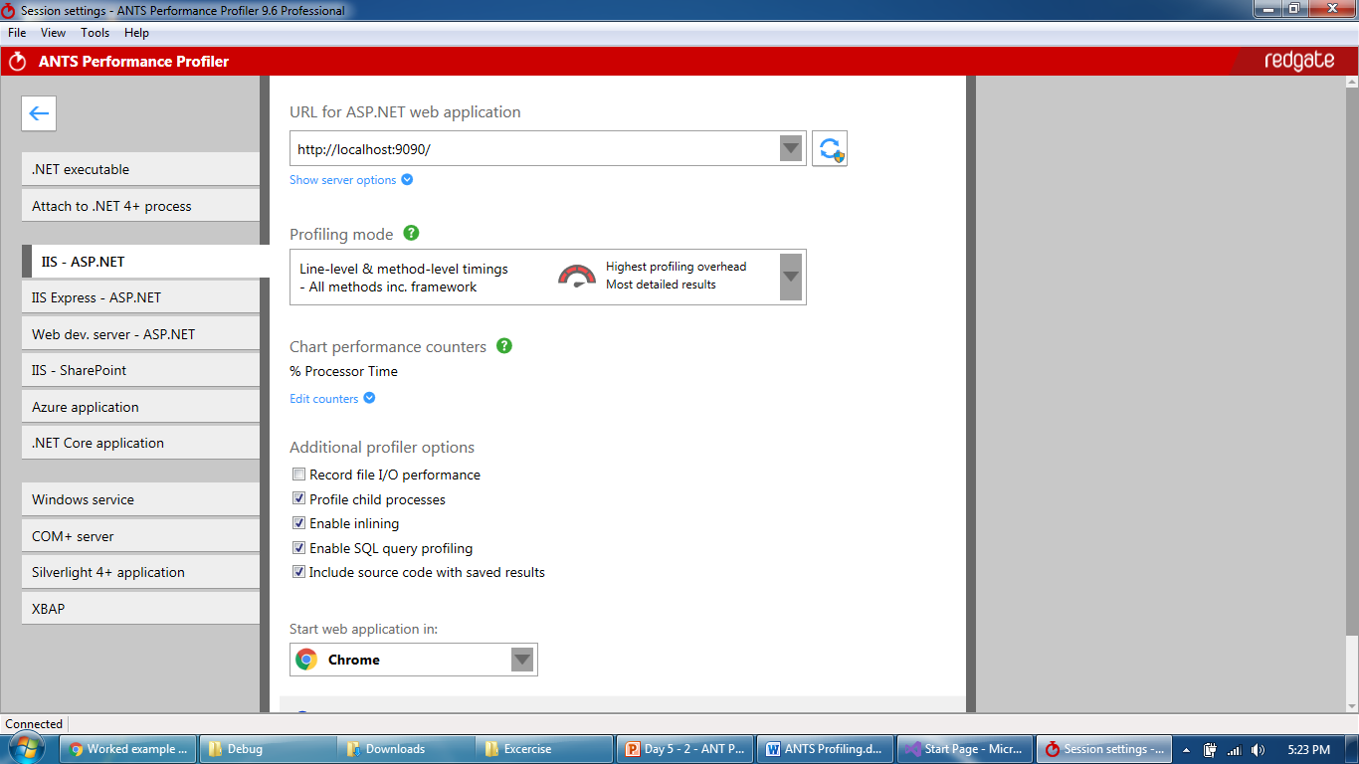
ANTS Profiler
Profiling can be started for a IIS web application hosted locally

Slide 15
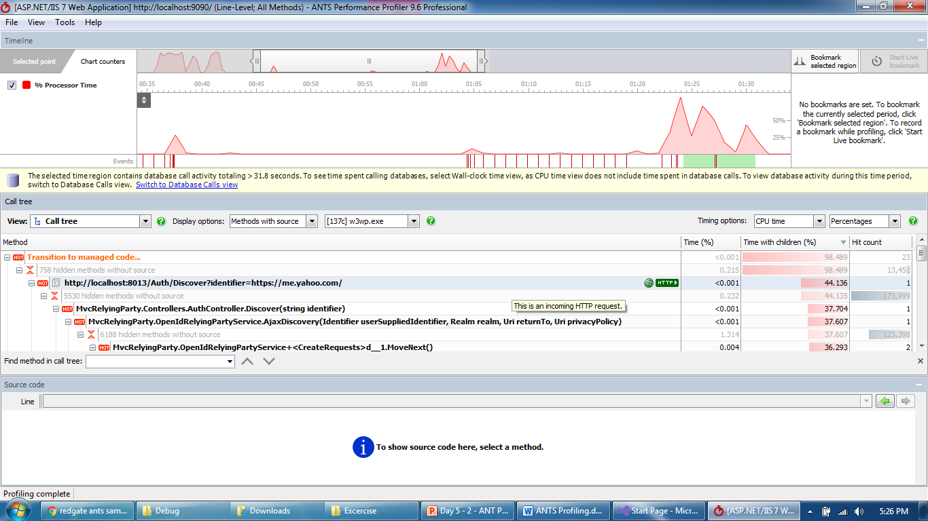
ANTS Profiler
Performance profile captured while accessing application

Slide 16
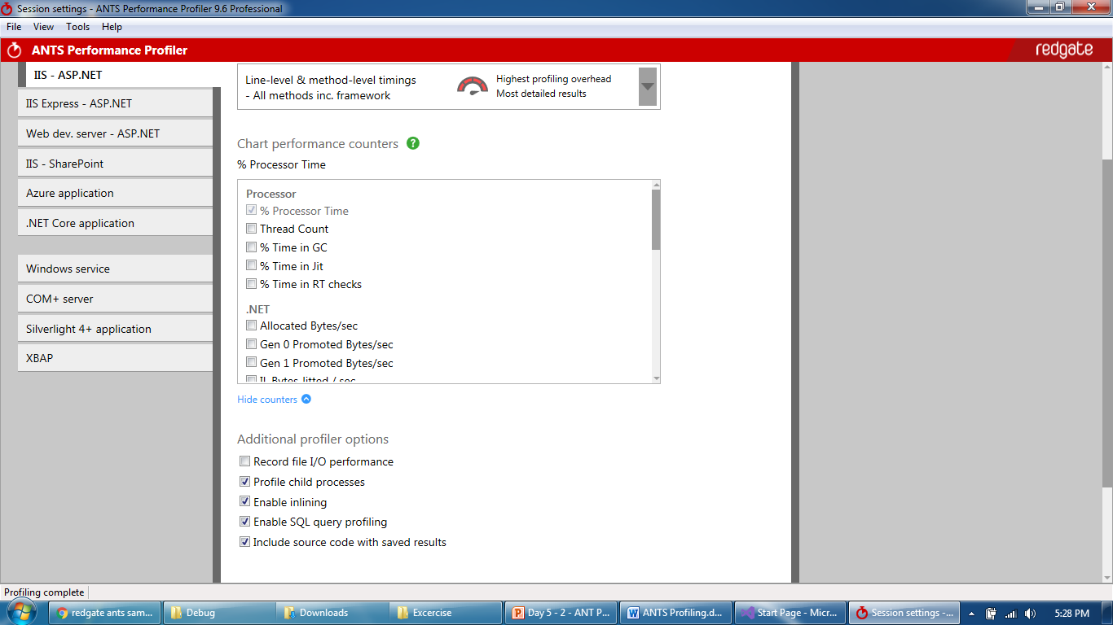
ANTS Profiler
One can edit the performance counters prior to starting a session

Slide 17
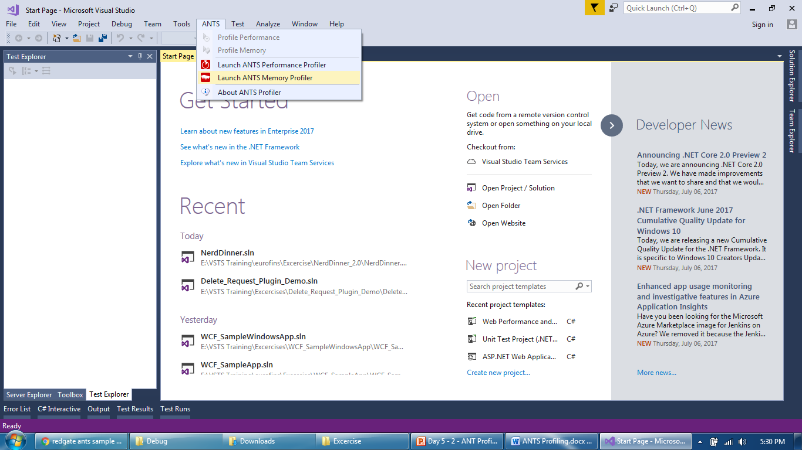
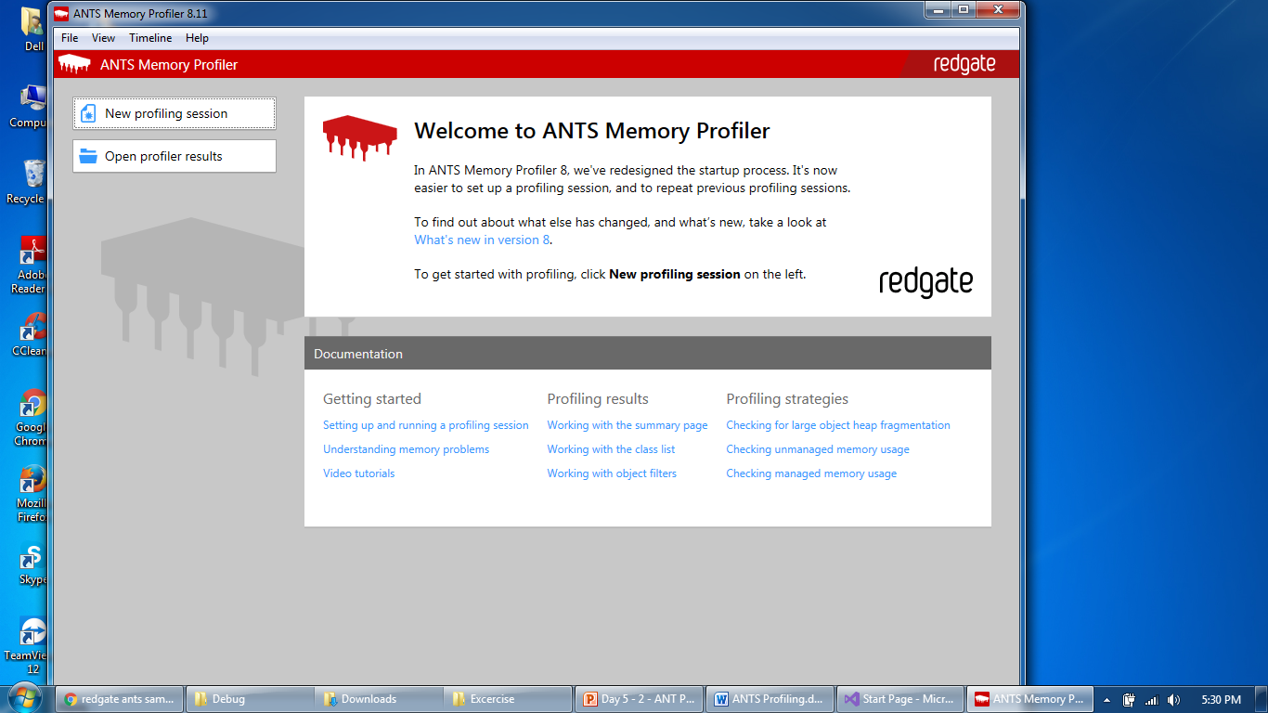
ANTS Profiler
One can edit the performance counters prior to starting a session

Slide 18
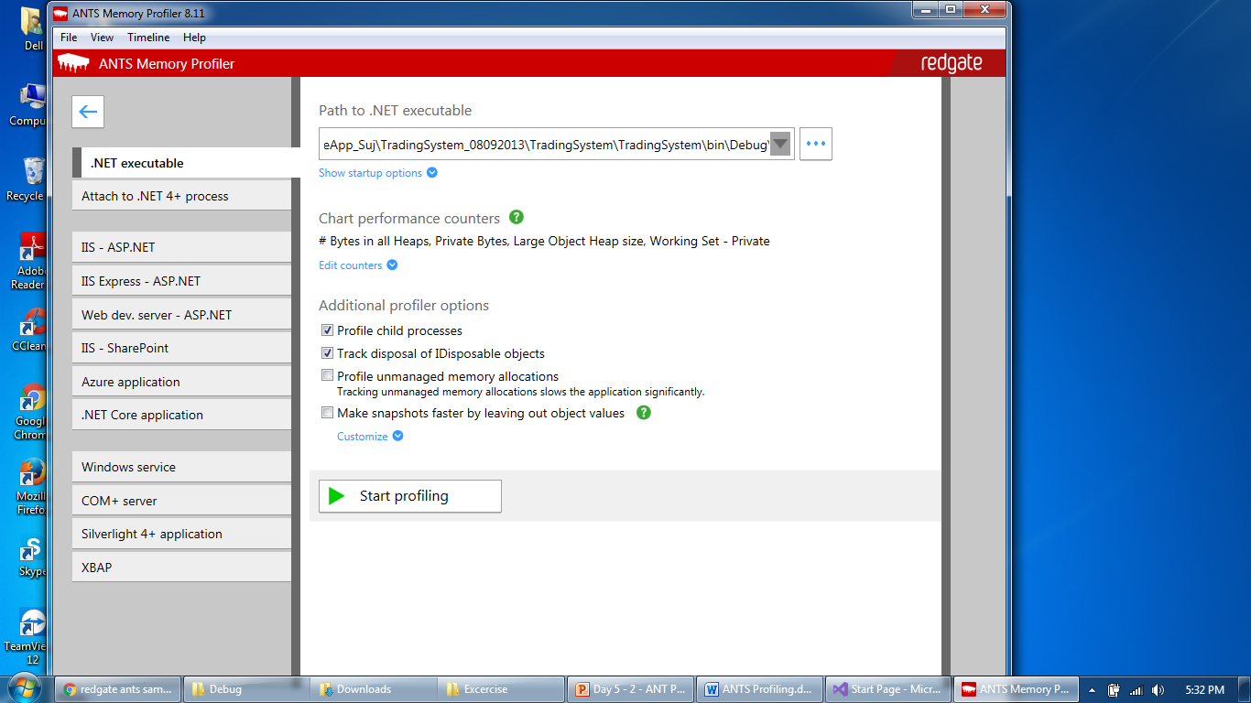
ANTS Profiler
Like Performance profiler, provide application and start Memory profiling

Slide 19
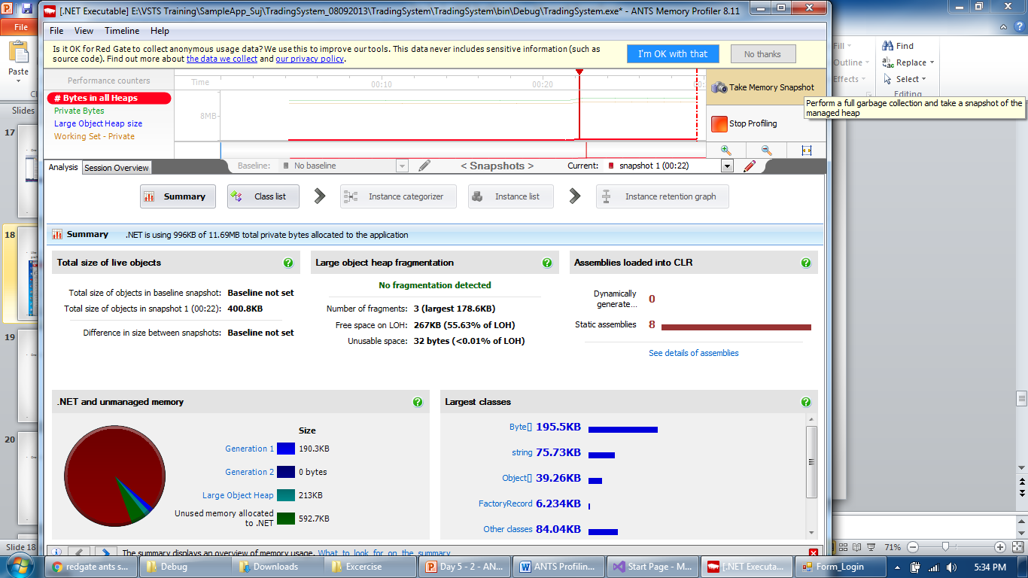
ANTS Profiler
Take snapshots for comparing heap memory usage

Slide 20
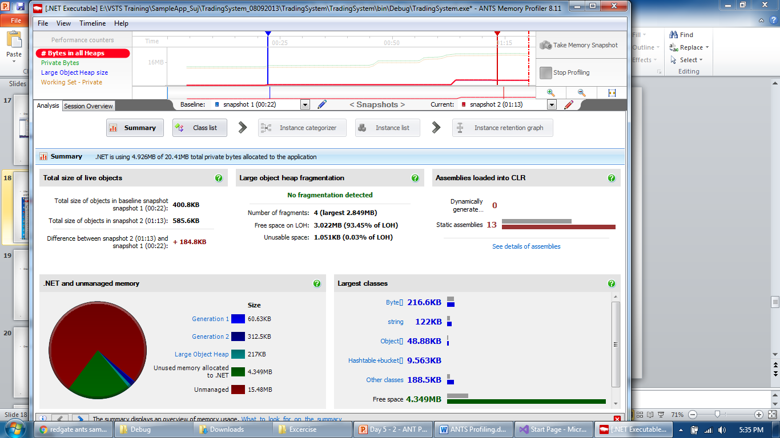
ANTS Profiler
Summary report will provide Heap Memory statistics

Slide 21
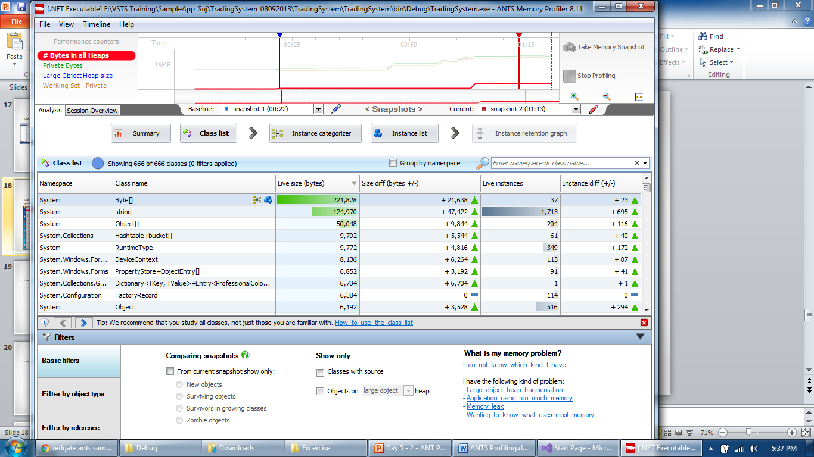
ANTS Profiler
Class list will show further drill down to classes level

Slide 22
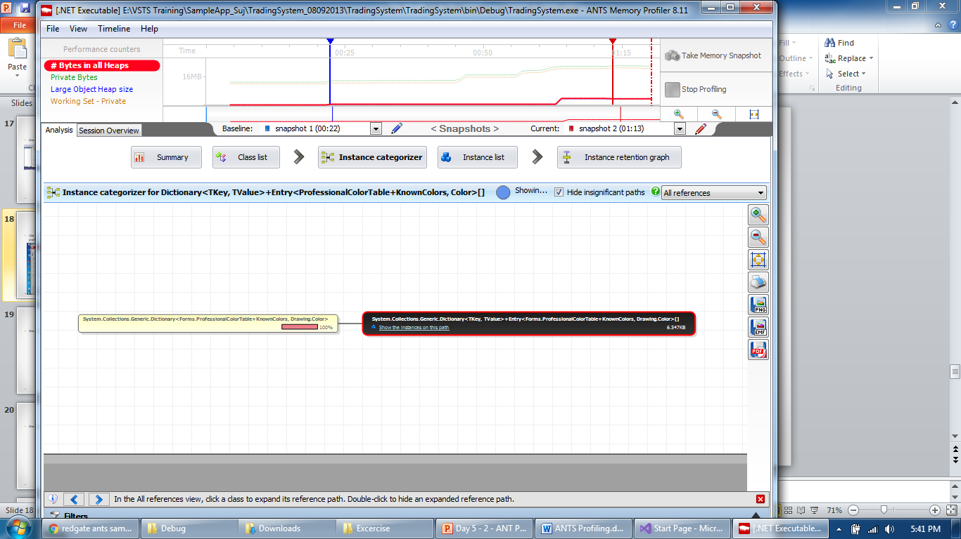
ANTS Profiler
Instance categorizer helps to reference objects to a known class

Slide 23
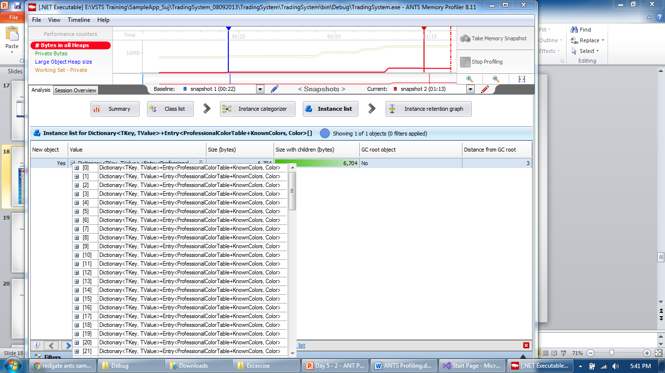
ANTS Profiler
Instance list helps to find values of every class

Slide 24
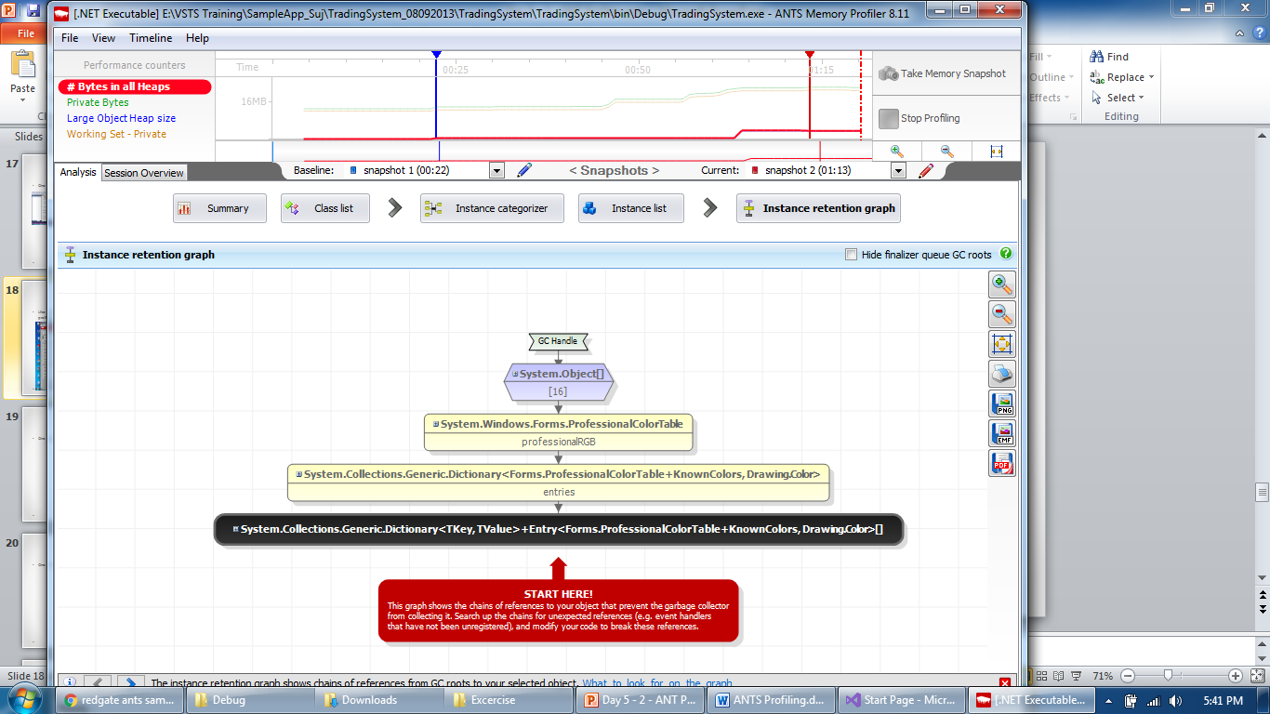
ANTS Profiler
Instance relationship graph shows chains of references to GC root

Slide 25
ANTS Profiler
Break references which are not supposed to be there between GC root and your object.
Retest after fixing the issue to verify the fix.

Slide 26
ANTS Profiler
Instance list helps to find values of every class

Slide 27
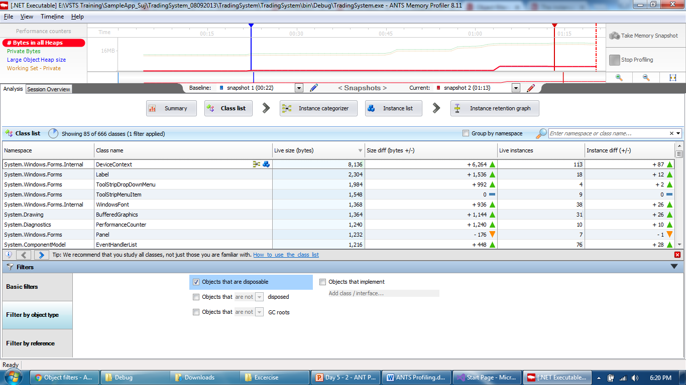
ANTS Profiler
Filters are applied to show select objects like Disposable Objects

Slide 28
Thank You

